Slide 1
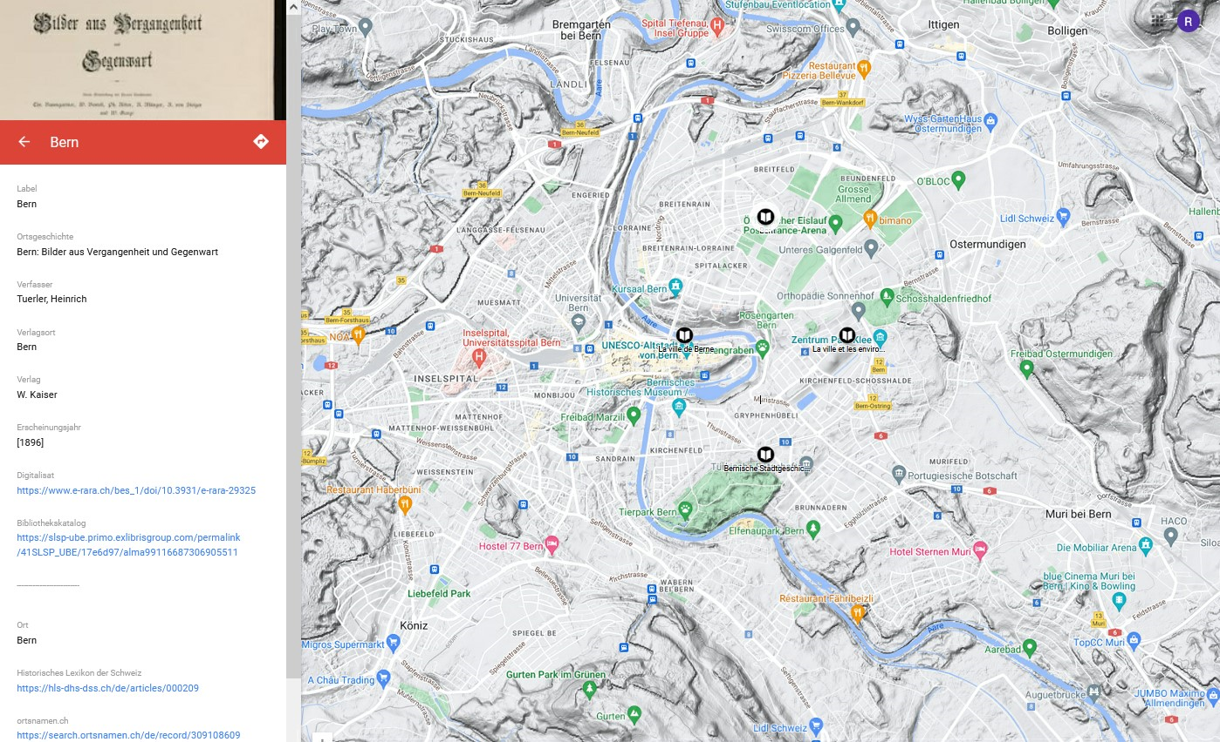
LOD Enrichement and Georeferencing of the ‘Berner Ortsgeschichten’ (Bernese Local Histories)
Linked Open Data in Dialogue
University of Bern
15 November 2023
René Frei & Thomas Hayoz

Slide 2
Project: Berner Ortsgeschichten
Making the Bibliography of Bernese History more visible and the local collection more accessible:
LOD Enrichement and Georeferencing of the ‘Berner Ortsgeschichten’
30,000+ Bibliography of Bernese History (BBG)
500+ Berner Ortsgeschichten (1975–) (990$b bbggr)
35 Berner Ortsgeschichten (19th c.) (> DigiBern)
bbggr = Bibliographie der Berner Geschichte GeoReferenziert
‘Ortsgeschichten’ are local histories which are dedicated to one specific place that is a village or a town.

Slide 3
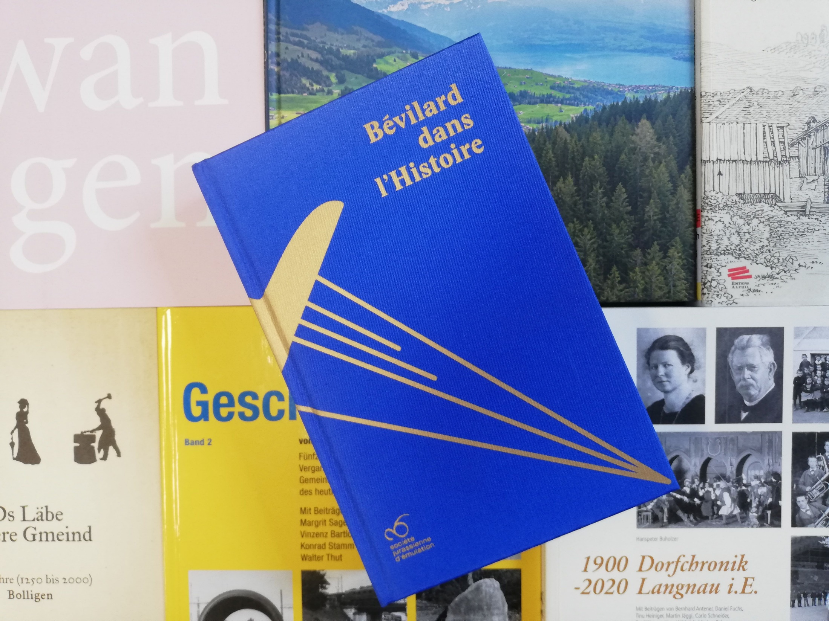
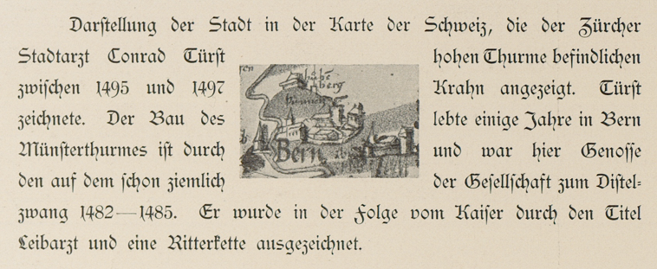
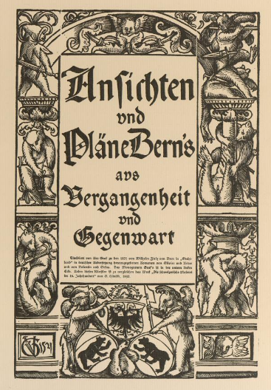
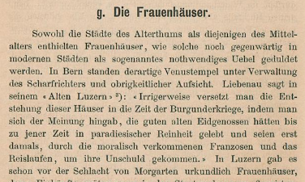
Berner Ortsgeschichten

Slide 4
Data Enrichment
Idea:
GND-ID >>> LOD & coordinates >>> map ☺
Reality:
The GND-ID (651$0) can’t be extracted from Alma >>> only the MARCXML of the whole record
A GND-ID is not really LOD
Different coordinate systems …
& the IT dep. had no time for our project

Slide 5
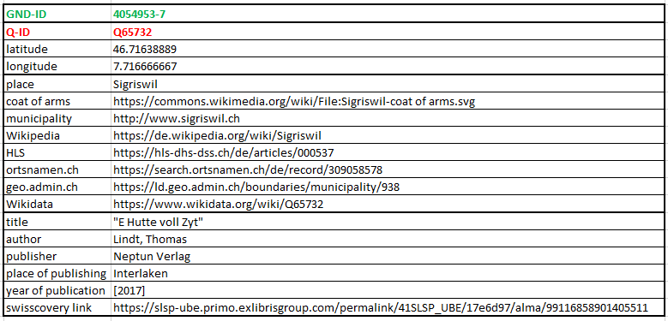
Desired Data

Slide 6
Procedure in the Pilot Project (35 Titles)
Alma SRU-API >>> MARCXML
Python >>> extract 651$0
Excel >>> complementing and cleaning GND-IDs
Python >>> enriching through GND-ID via muenzfunde.ch
Excel >>> adding coordinates and cleaning everything
Python >>> enriching through Wikidata-ID (from muenzfunde.ch)
Excel >>> adding and cleaning everything
Google My Maps >>> uploading Excel & making many adjustments
SRU = Search/Retrieve via URL
https://slsp-ube.alma.exlibrisgroup.com/view/sru/41SLSP_UBE?version=1.2&operation=searchRetrieve
&recordSchema=marcxml&maximumRecords=50&startRecord=51&query=alma.local_field_990=bbggr

Slide 7
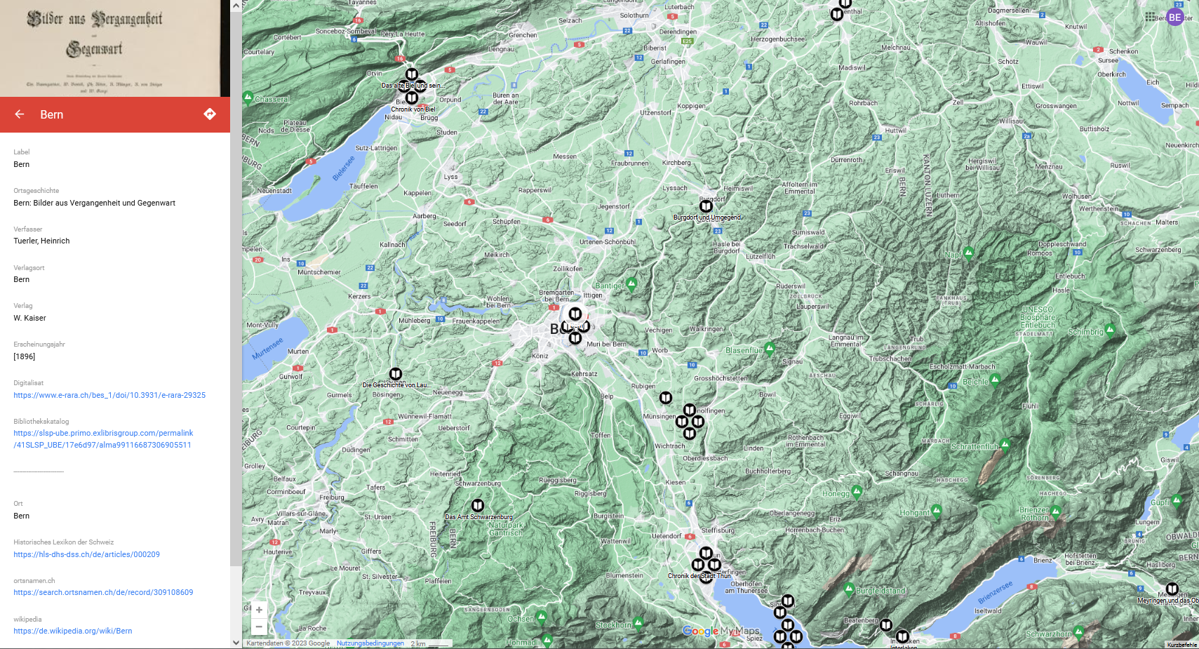
https://www.google.com/myMaps

Slide 8
Procedure in the Main Project (500+ Titles)
1 Python-Script
>>> Alma SRU-API >>> MARCXML >>> GND-IDs
>>> enrich from lobid.org & muenzfunde.ch to get wikidata-ID
>>> enrich from wikidata to get coordinates & more
>>> export as .json
>>> IT dep. implements the map (OpenStreetMap & Leaflet)

Slide 9
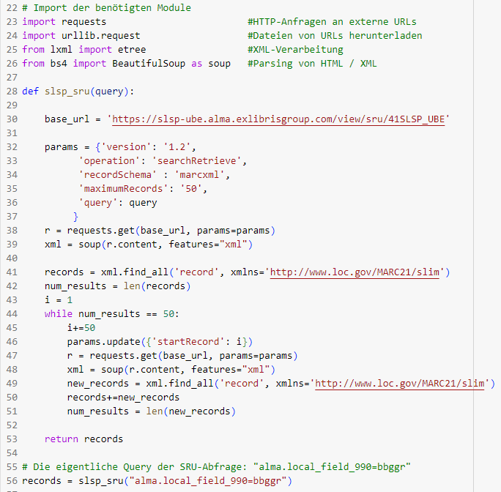
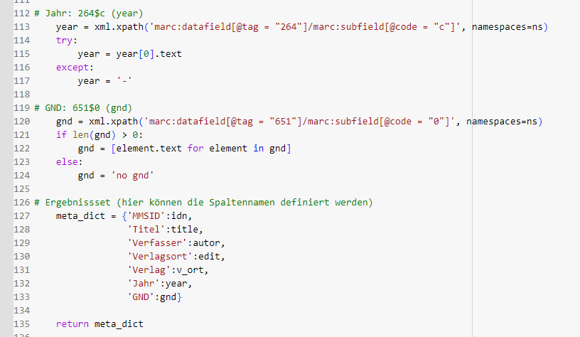
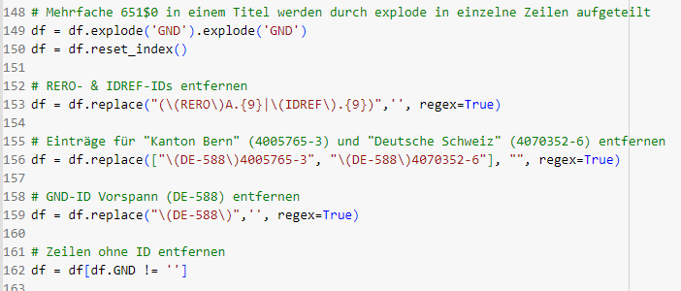
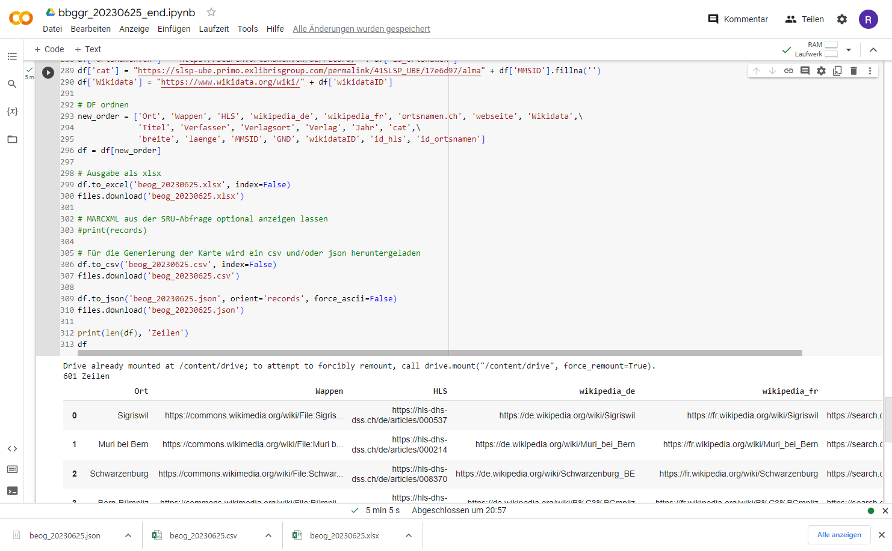
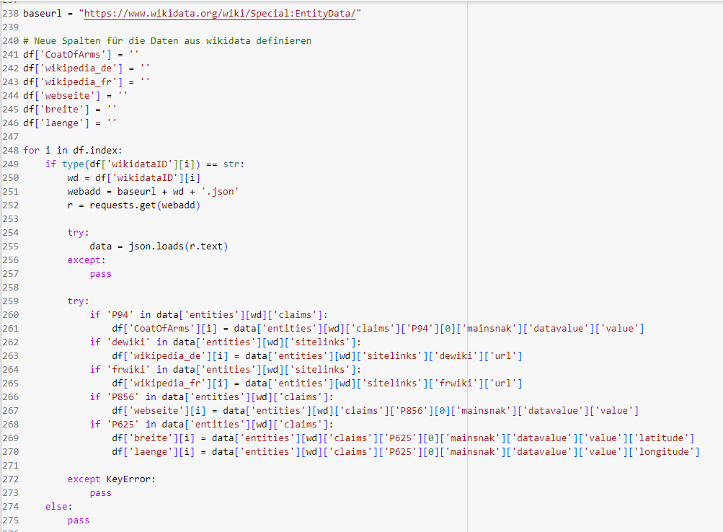
Python-Script
parse XML
explode&regex
SRU
output
Wikidata

Slide 10
Results
Sobering !

Slide 11
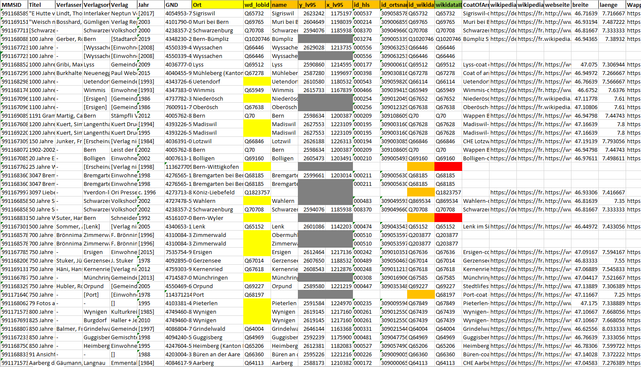
Results

Slide 12
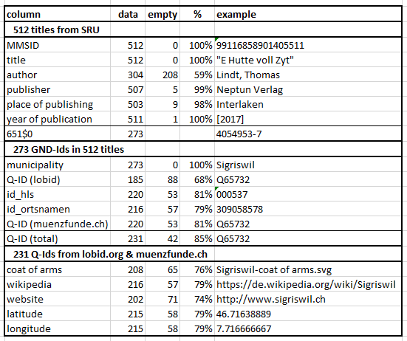
Results
Lobid >>> 68% Q-IDs
Münzf. >>> 81% Q-IDs
Total >>> 85% Q-IDs
But in a short search
>>> 95% found in Wikidata!

Slide 13
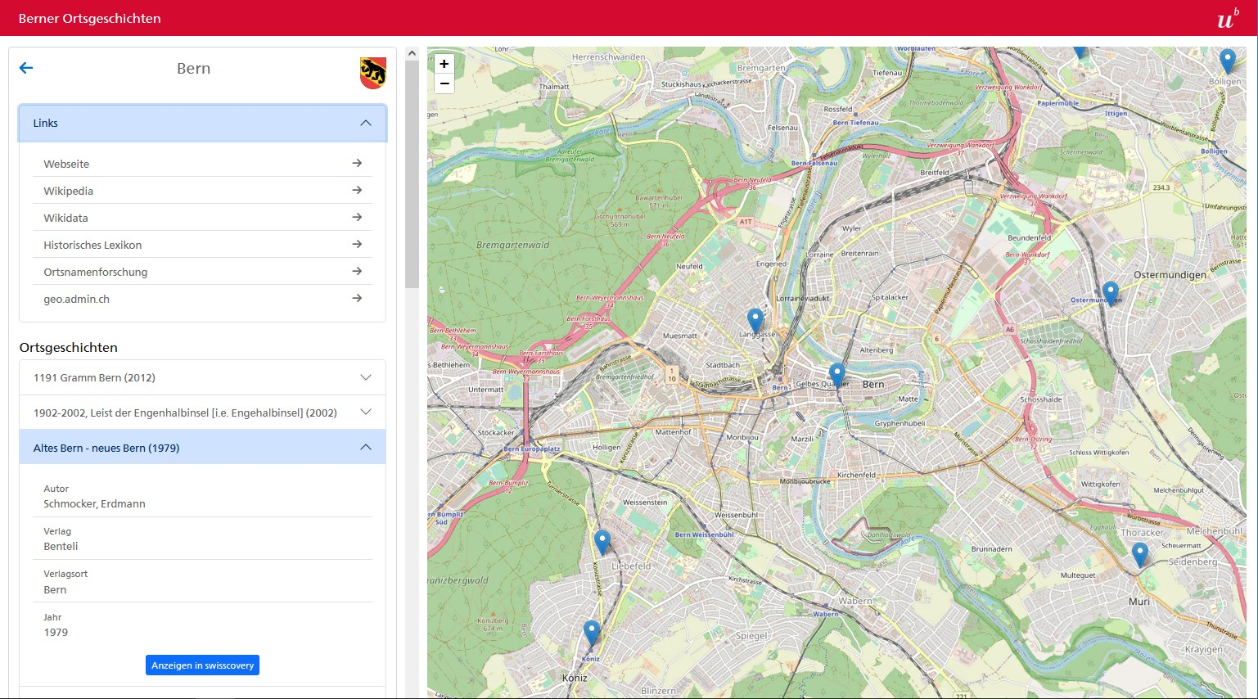
[Proof of Concept]
http://berner-ortsgeschichten.test.ub.unibe.ch/

Slide 14
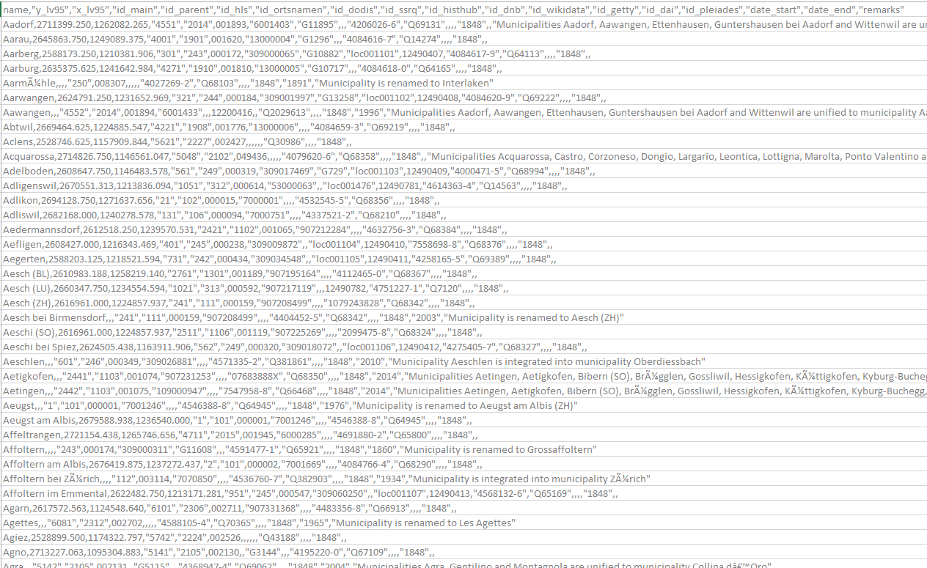
Insights
There comes a time when it‘s not worth it to expand your script
or dig into new sources for maybe 1% more Q-Ids!
So we decided to optimize the source (a new table of our own).
>>> BEOT
(Berner OrtsTabelle)
Based on:
muenzfunde.ch
GeoNames (coordinates BE)
Alma (GND-IDs for places in BE)
First, for 273 places from the ‘Berner Ortsgeschichten’, and then later for the remaining 770 localities in Bern

Slide 15
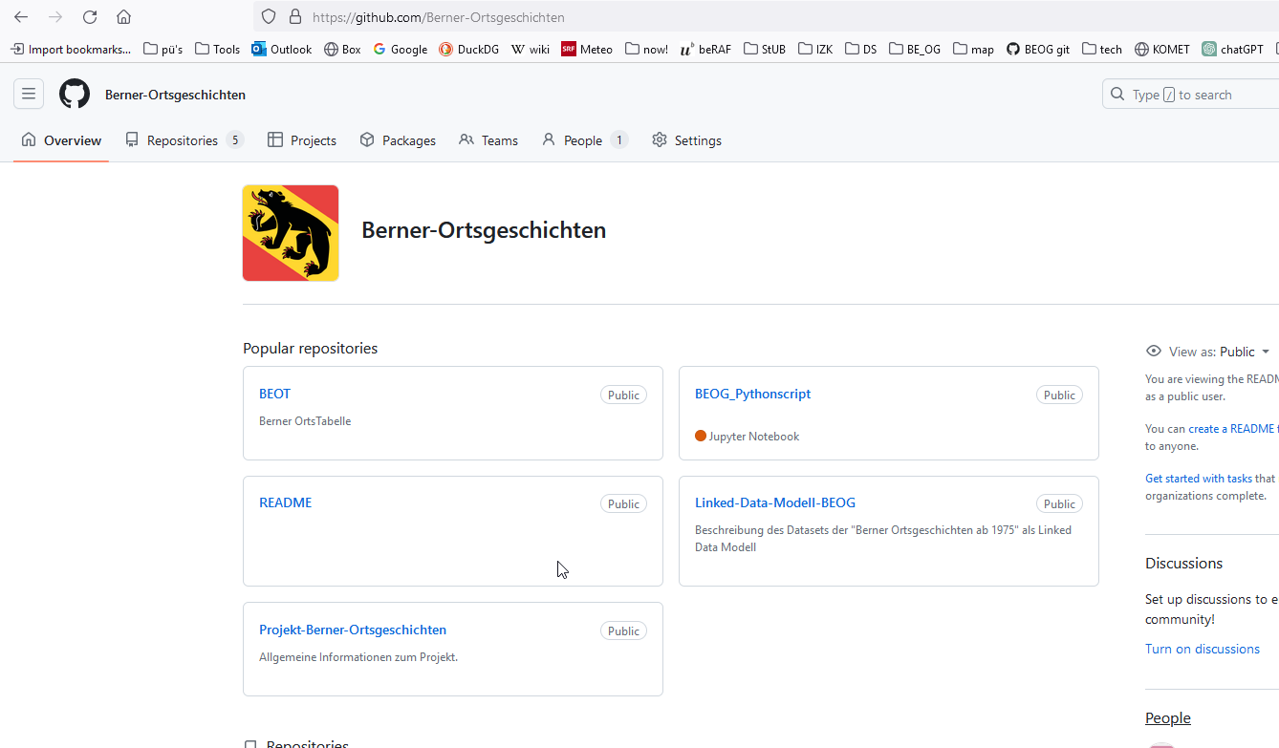
BEOT & other resources on GitHub
https://github.com/Berner-Ortsgeschichten

Slide 16
@prefix rdf: <http://www.w3.org/1999/02/22-rdf-syntax-ns#> .
@prefix rdfs: <http://www.w3.org/2000/01/rdf-schema#> .
@prefix bf: <http://bibframe.org/vocab/> .
@prefix bflc: <http://id.loc.gov/ontologies/bflc/> .
@prefix alma: <https://open-eu.hosted.exlibrisgroup.com/alma/41SLSP_UBE/bf/> .
@prefix wikidata: <https://www.wikidata.org/wiki/> .
@prefix owl: <http://www.w3.org/2002/07/owl#> .
@prefix xsd: <http://www.w3.org/2001/XMLSchema#> .
<alma:entity/99117157377505511#Work>
bf:title "Aarberg dazumal" ;
bf:creator <http://viaf.org/viaf/sourceID/DNB/116337419/> ;
bf:subject bf:Place ;
bf:Place <http://d-nb.info/gnd/4084617-9> ;
bf:label "Aarberg" ;
bf:identifiedBy [ a bf:gnd ;
rdf:value "4084617-9" ] .
bf:instance
rdf:resource <http://id.loc.gov/vocabulary/issuance/mono/> ;
bf:instance <alma:entity/instance/99117157377505511> ;
bflc:simpleAgent "Emmentaler Druck" ;
bflc:simplePlace "Langnau" ;
bflc:simpleDate "[1984]" ;
bf:identifiedBy [ a bf:Identifier ;
bf:source [rdfs:label "https://open- eu.hosted.exlibrisgroup.com/alma/" ] ;
rdf:value "99117157377505511" ] .
<http://viaf.org/viaf/sourceID/DNB/116337419/> bf:label "Gäumann, Ernst Albert" .
<http://d-nb.info/gnd/4084617-9> owl:sameAs wikidata:Q64113 .
wikidata:Q64113
wikidata:P625 "47.04583333333"^^xsd:decimal , "7.276388888889"^^xsd:decimal ;
wikidata:P94 <https://commons.wikimedia.org/wiki/File:CHE_Aarberg_COA.svg> ;
wikidata:P856 <https://www.aarberg.ch/> ;
owl:sameAs <https://de.wikipedia.org/wiki/Aarberg> ;
owl:sameAs <https://hls-dhs-dss.ch/de/articles/000172> ;
owl:sameAs <https://search.ortsnamen.ch/de/record/309000065> ;
wikidata:P1325 <https://ld.geo.admin.ch/boundaries/municipality/301> .
Outlook
In the short term:
Complementing and cleaning the data in Wikidata
Adding Q-IDs to the records of the Integrated Authority File (GND)
In the medium term:
Enrichment of further selected data subsets from the Bibliography of Bernese History
A LOD-enriched special edition of the bibliography for the occasion of the Reformation Jubilee (1528-2028)?
BBG data dumps
In the long term:
Integration of LOD into the library catalogue

Slide 17
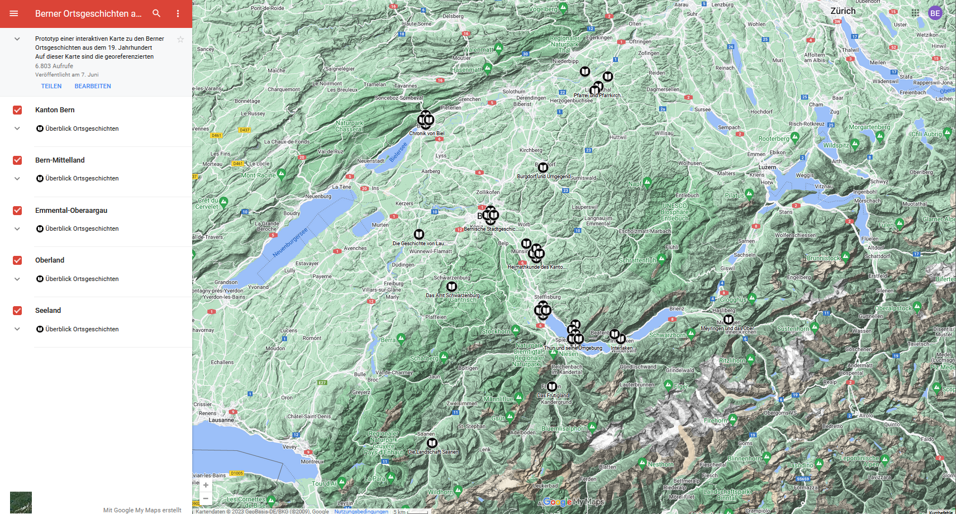
This is NOT the end!
Kontakt:
ds.ub@unibe.ch
rene.frei@unibe.ch
thomas.hayoz@unibe.ch
Further resources: https://github.com/Berner-Ortsgeschichten

